Slide 1





Power BI
Dashboards and Reports
Nashville Software School

Slide 2



Quick Recap
Formulas
Pivot tables
Excel Dashboards
Query
Build tables
Aggregate and create columns
Join tables based on relationships
Power BI – All of that with better graphics and auto-programmed data transformation

Slide 3

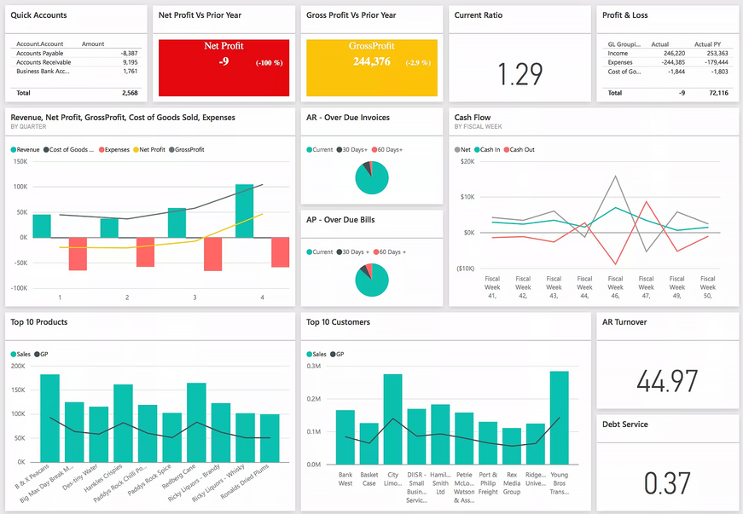
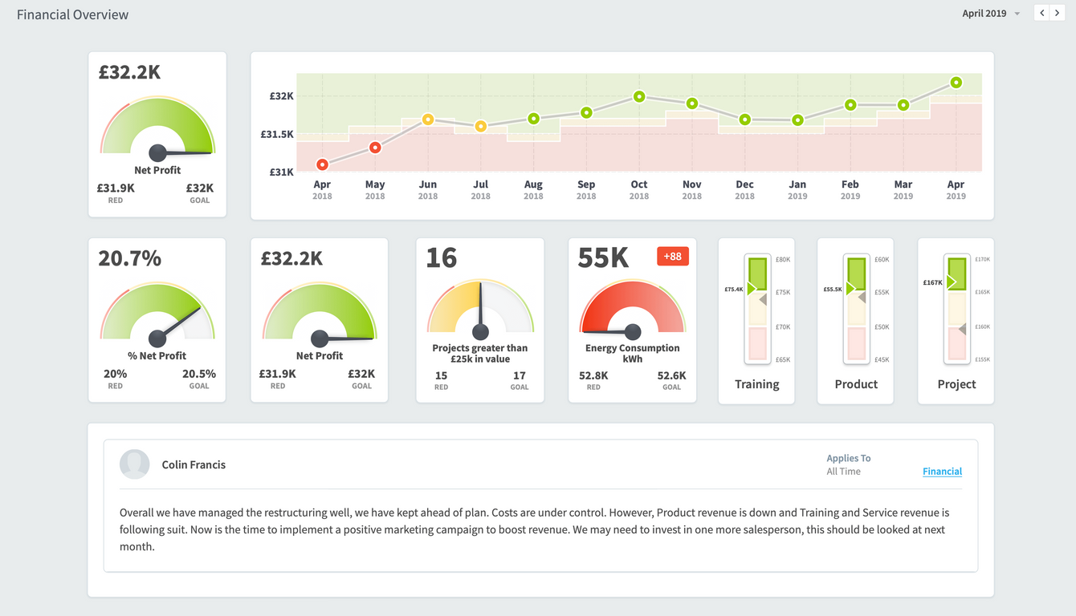
Dashboards Vs. Reports
Dashboard
A dashboard is a birds eye view of real time reporting.

Slide 4
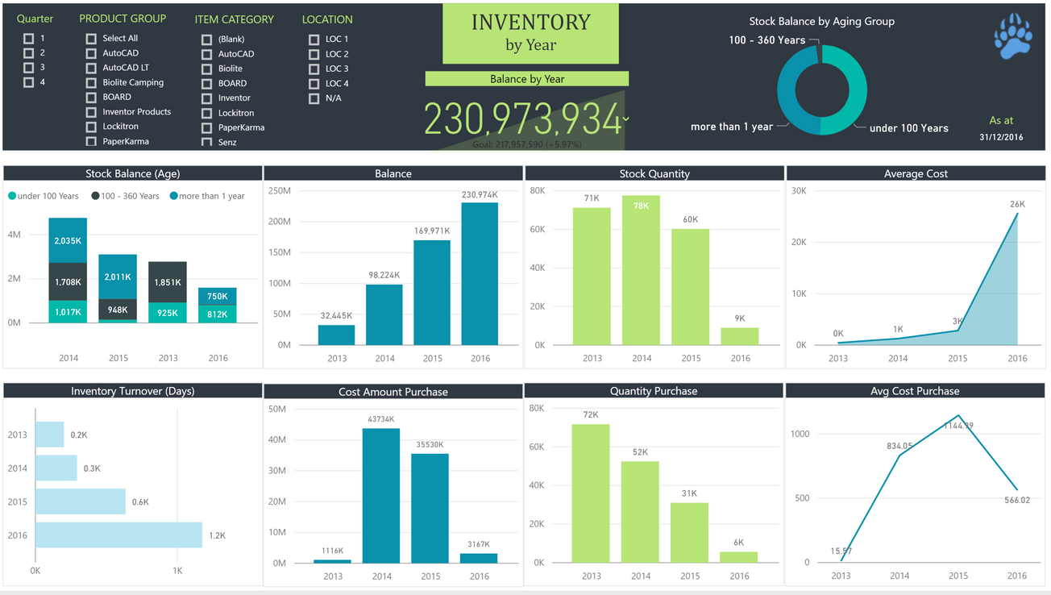
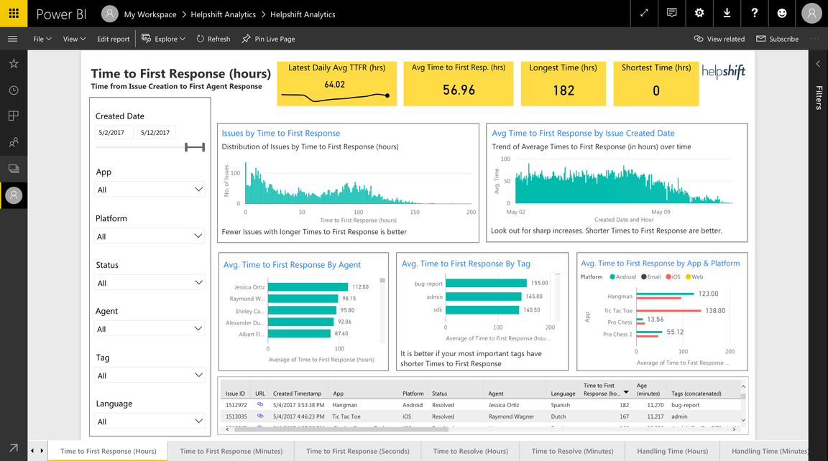
Dashboards Vs. Reports
Reports
A report has a specific start and end time, ad hoc - for a specific purpose

Slide 5
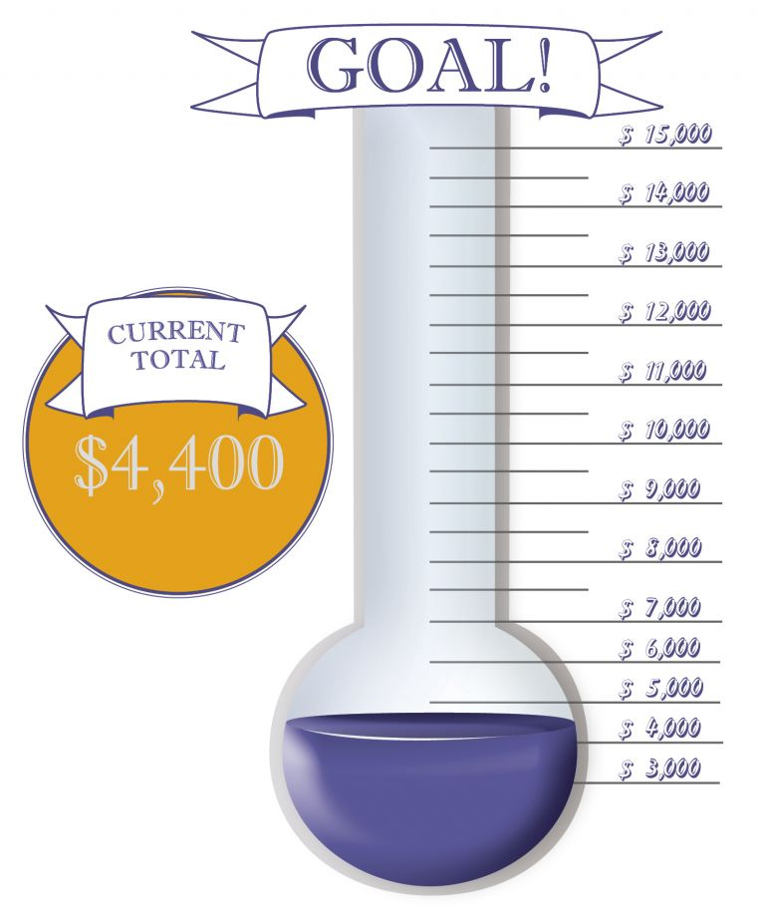
Tenets of a good dashboard
A good dashboard should be like a good joke - it should not need explanation.
Titles, subtitles, buttons with clear end-user instructions, color consistency
A good dashboard understands who the audience is.
What terminology do they use? What are they interested in? What is their data question?
A good dashboard provides unbiased insight into the relationship between two or more variables.

Slide 6






Dashboard Process is Iterative
Data Question
Meet with stakeholders to understand their pain points, concerns, and needs.
Investigate
Find, extract, and transform the data. Explore the tables and relationships.
Visualize
Exploratory analysis, draft findings.
Craft visuals to lead stakeholders towards data-driven decision making.
Present
Present your visuals to the stakeholders. Receive feedback and implement enhancements.
Encourage discussions about the data and foster data-driven decision making.

Slide 7




Business Intelligence
Business intelligence (BI) leverages software and services to transform data into actionable insights that inform an organization’s strategic and tactical business decisions. BI tools access and analyze data sets and present analytical findings in reports, summaries, dashboards, graphs, charts and maps to provide users with detailed intelligence about the state of the business.
Source: https://www.cio.com/article/2439504/business-intelligence-definition-and-solutions.html

Slide 8
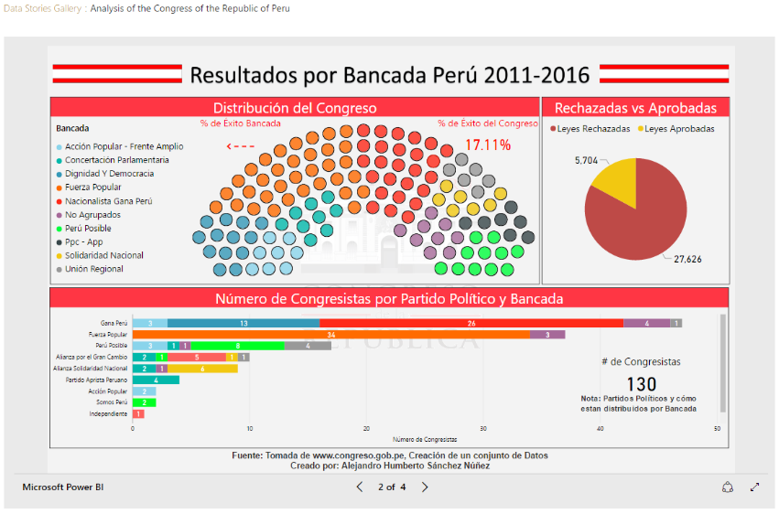
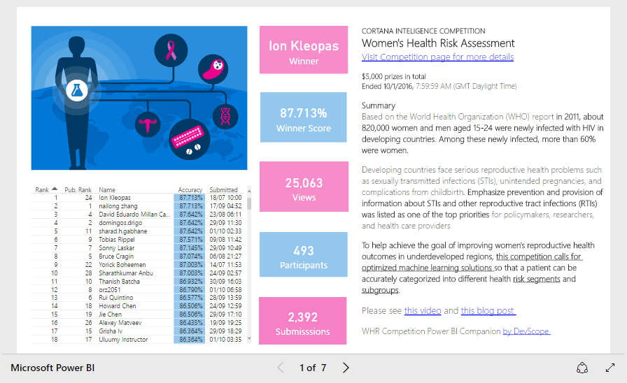
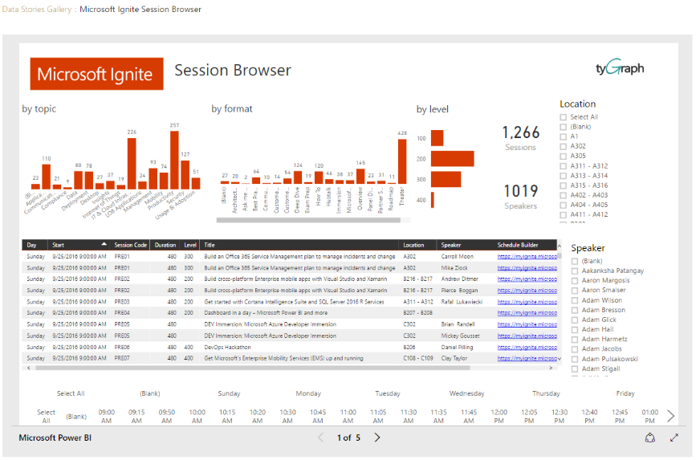
Power BI Community
Microsoft Power BI Community - Microsoft Fabric Community
Data Stories Gallery

Slide 9




Human brain processes images 60,000x faster than text.
-Persuasion and the Role of Visual Presentation Support: The UM/3M Study, 1986
90 percent of the information transmitted to the brain is visual.
-MIT News, January 16, 2014

Slide 10
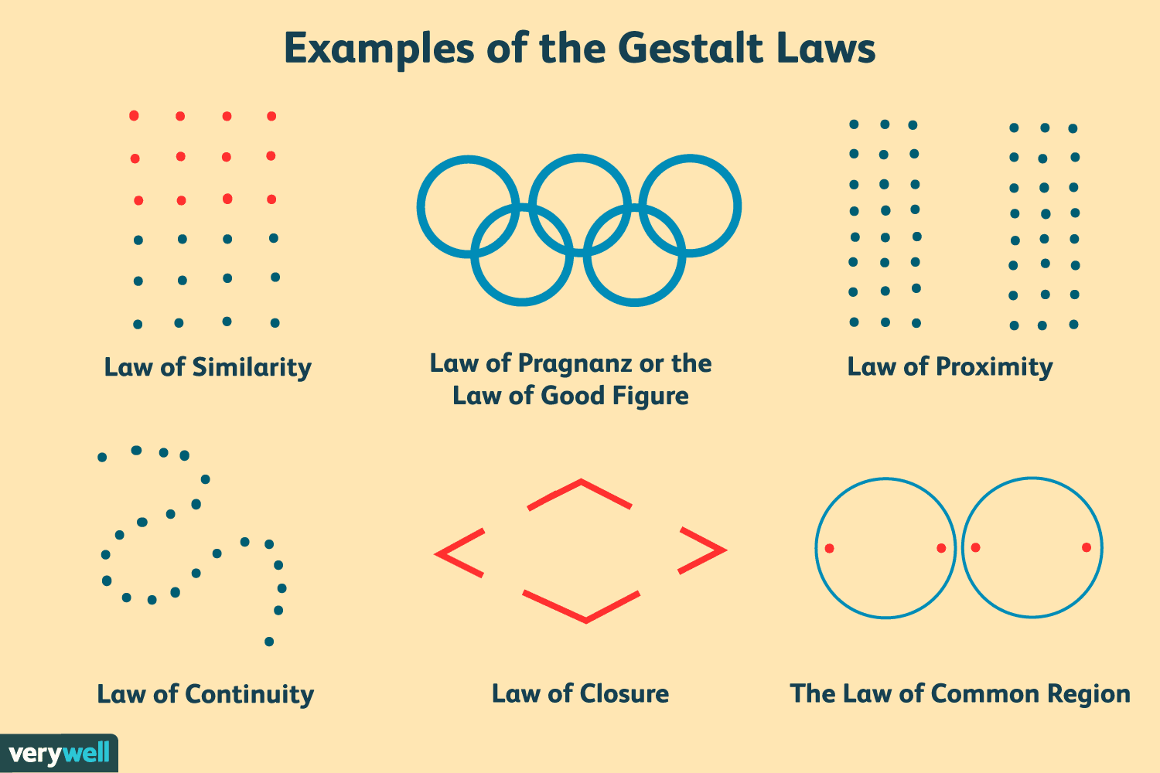
Gestalt - 6 Principles of Visual Perception
How to Apply Gestalt Design Principles to Your Visual Content for Maximum Impact (visme.co)

Slide 11
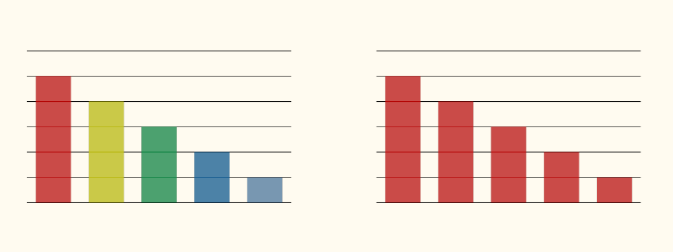
Similarity

Slide 12
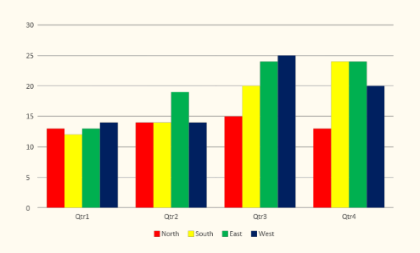
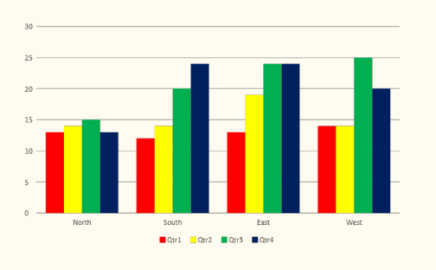
Proximity

Slide 13
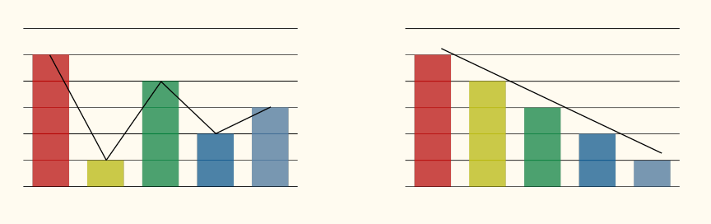
Continuity

Slide 14
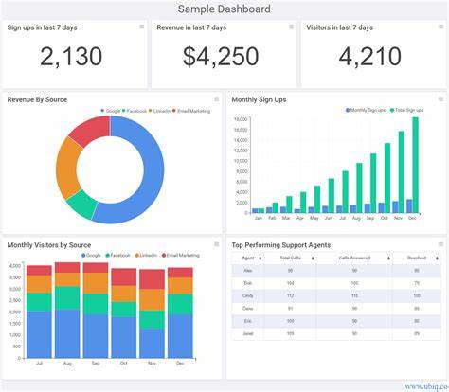
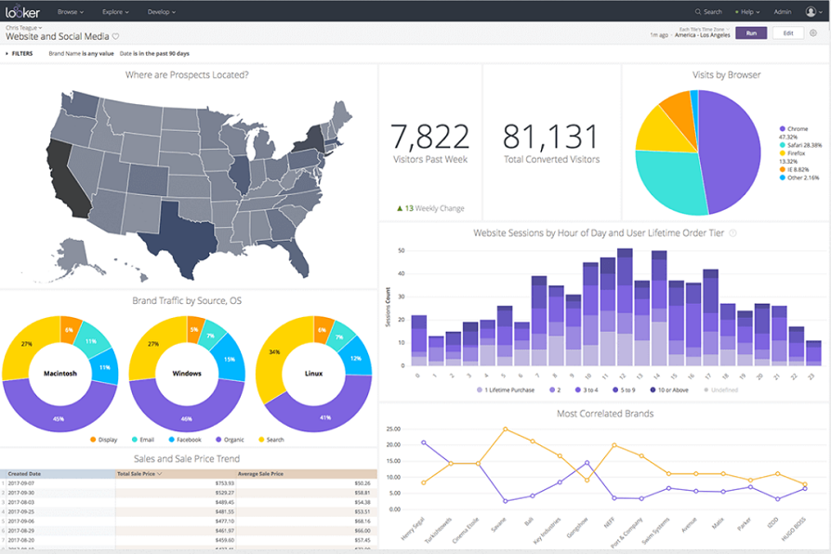
Gestalt Principles in Dashboards

Slide 15
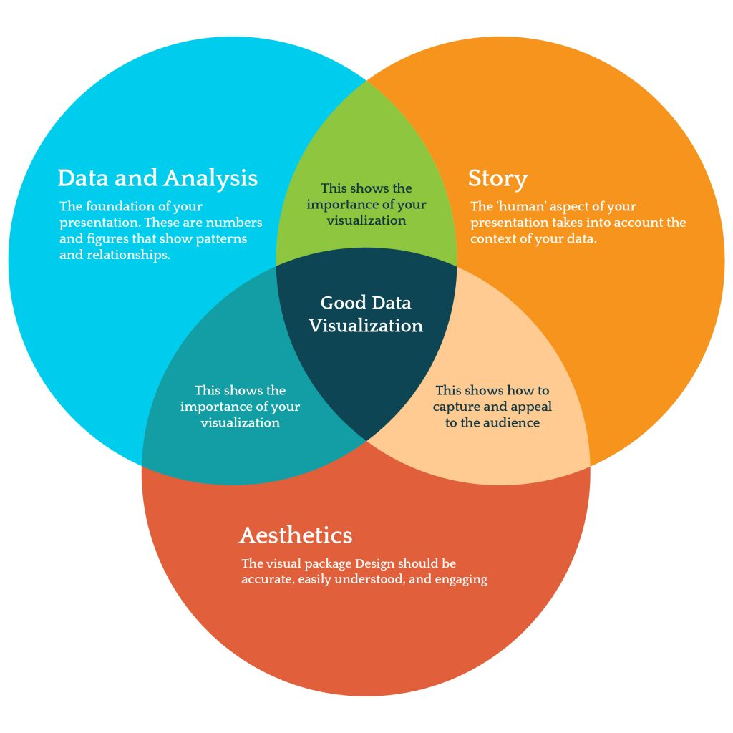

Slide 16
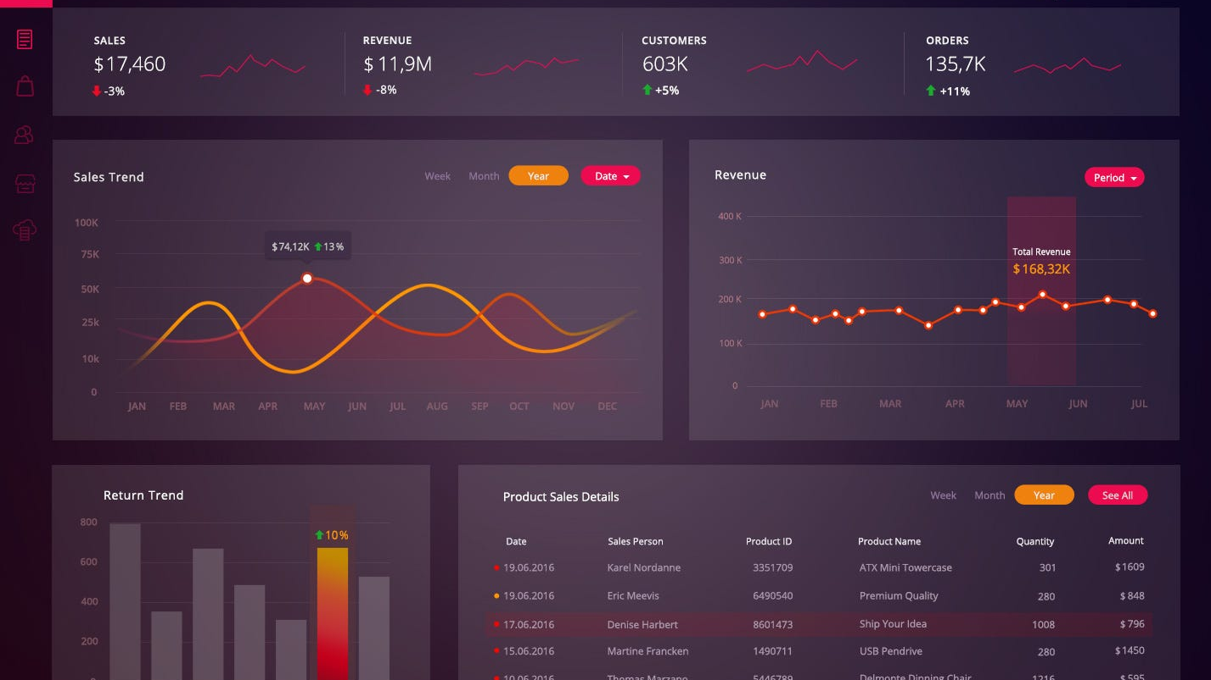

Slide 17
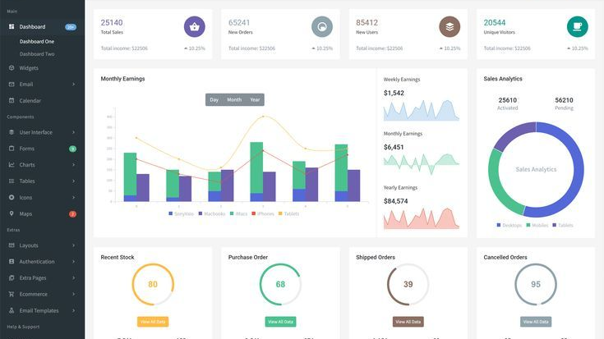

Slide 18
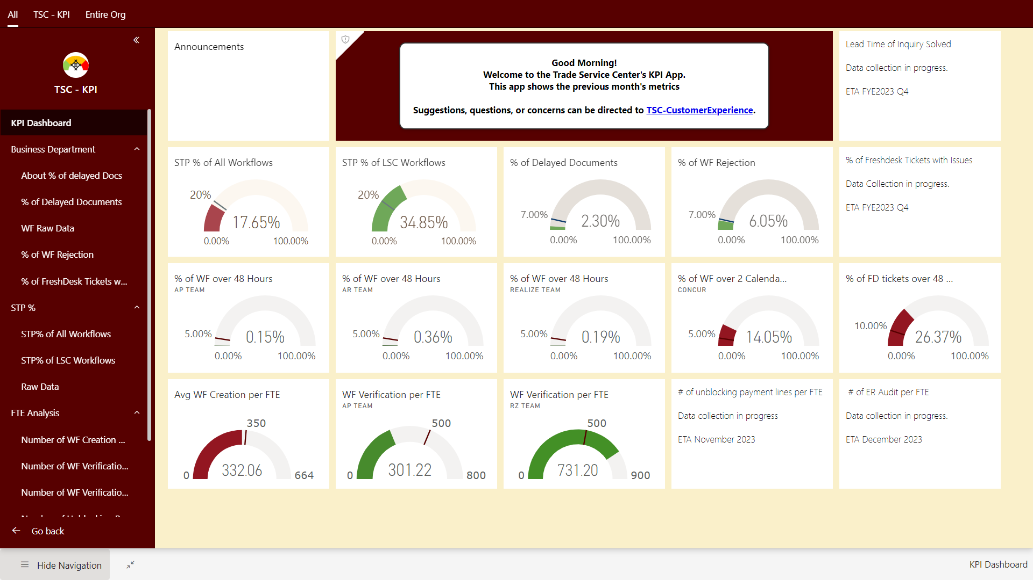
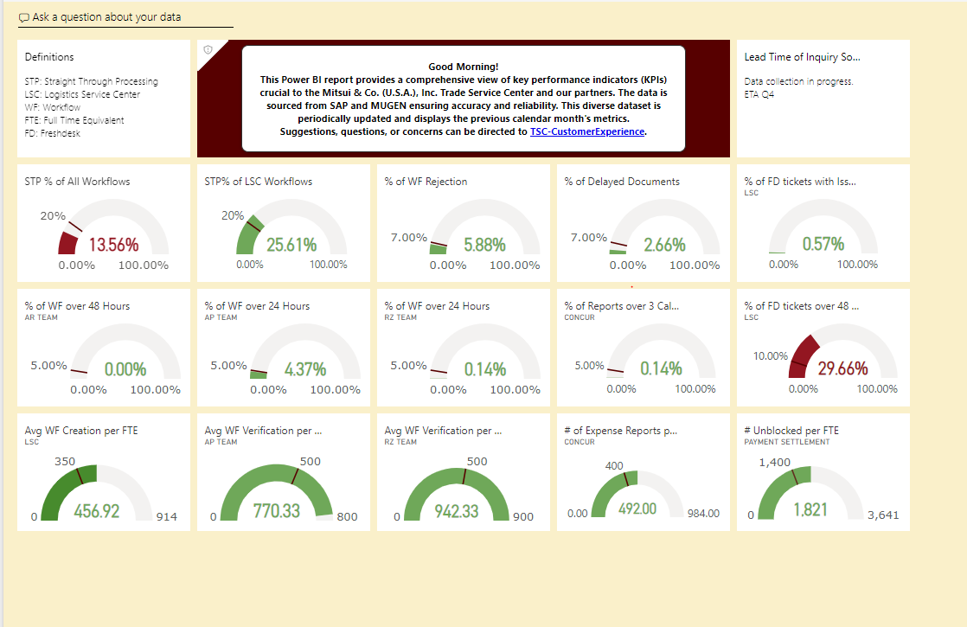

Slide 19
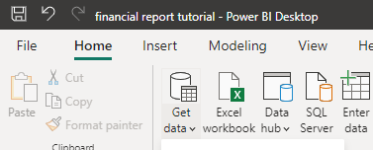
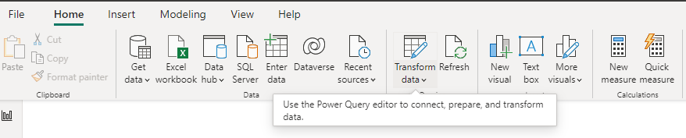
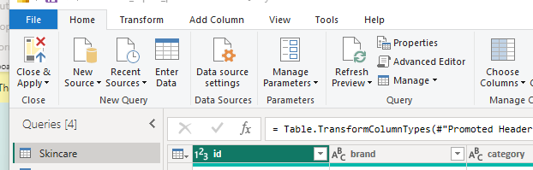
ETLV
Extract – 80+ data source connections
Transform – Create Columns, Merge Queries, Link tables
Load – Close & Apply
Visualize – Go Wild! Then Edit

Slide 20
Power BI Terminology
Facts - Quantitative Information
Expressed in numbers and can be counted and aggregated easily
Dimensions - Descriptive/ Qualitative Information
Color
Country
Region
State
City
Person
Gender
Age
Dates

Slide 21
Power BI Terminology
Scenario 1
How many shoes were sold in Tennessee in 2017?

Slide 22
Power BI Terminology
Scenario 1
How many shoes were sold in Tennessee in 2017?

Slide 23
Power BI Terminology
Scenario 2
How many kids under the age of 10 bought red Nikes in the USA in 2018?

Slide 24
Power BI Terminology
Scenario 2
How many kids under the age of 10 bought red Nikes in the USA in 2018?

Slide 25
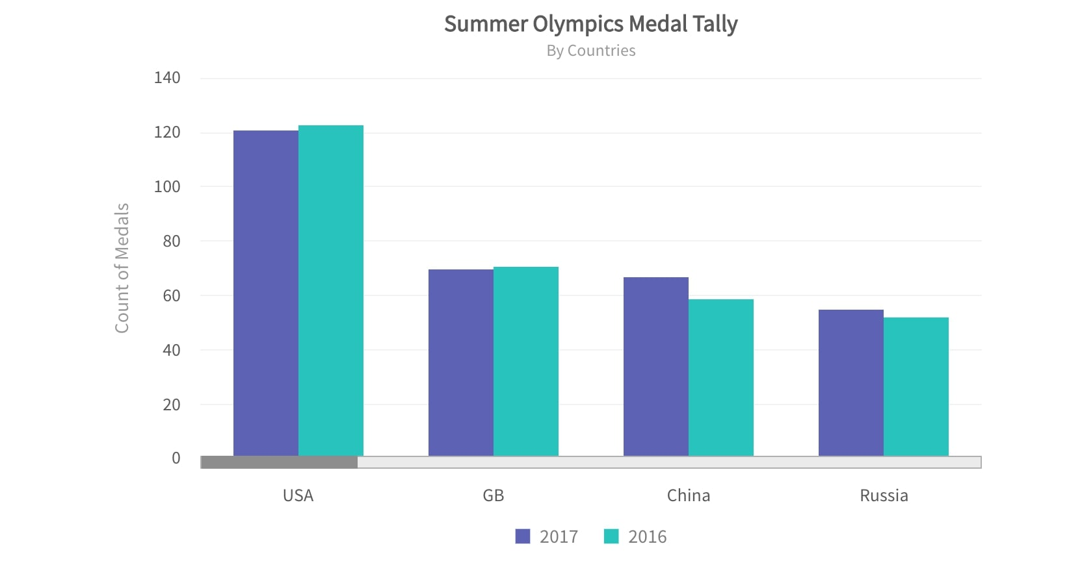
Power BI Terminology
Facts
SELECT FACT
FROM TABLE
GROUP BY DIMENSION
Dimensions

Slide 26
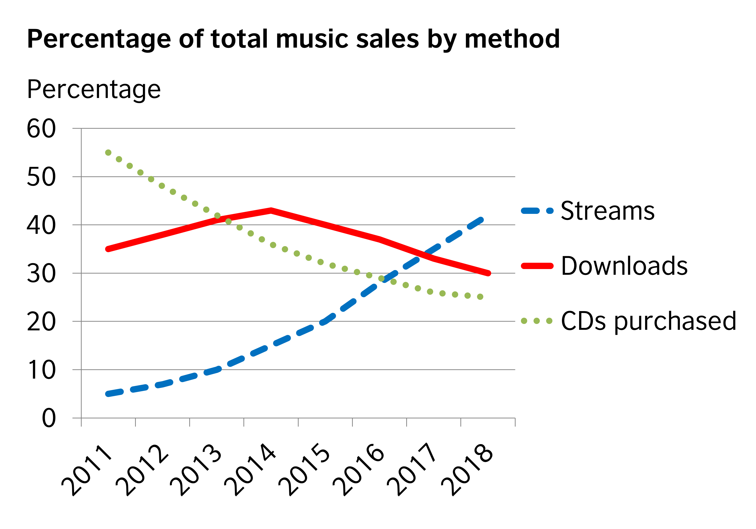
Power BI Terminology
Facts
SELECT FACT
FROM TABLE
GROUP BY DIMENSION_1, DIMENSION_2, DIMENSION_3, DIMENSION_4
Dimensions

Slide 27
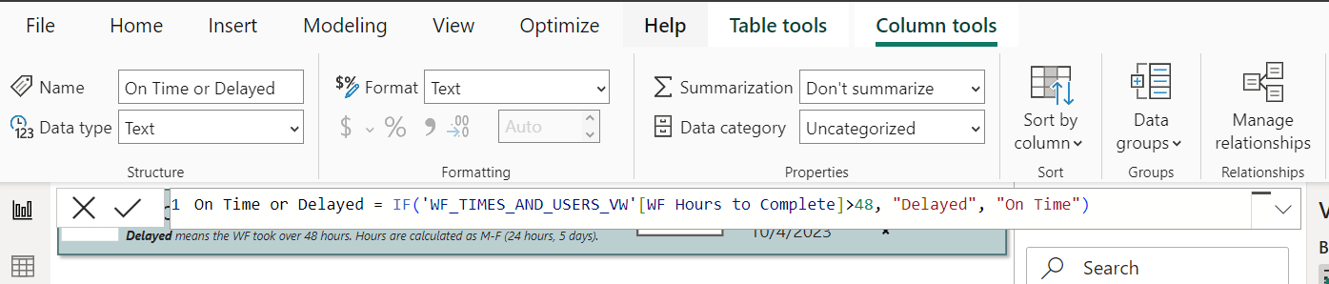
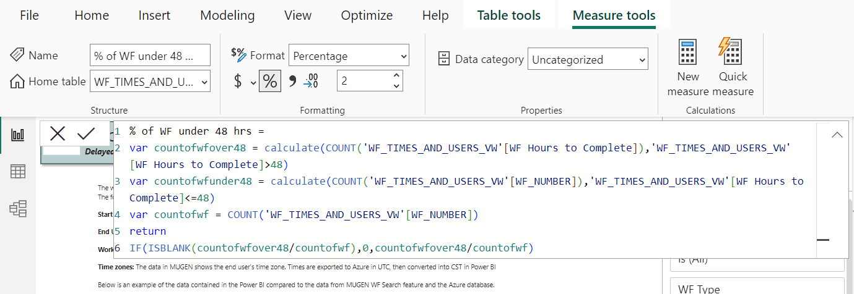
Power BI Terminology
DAX – Data Analysis Expressions

Slide 28
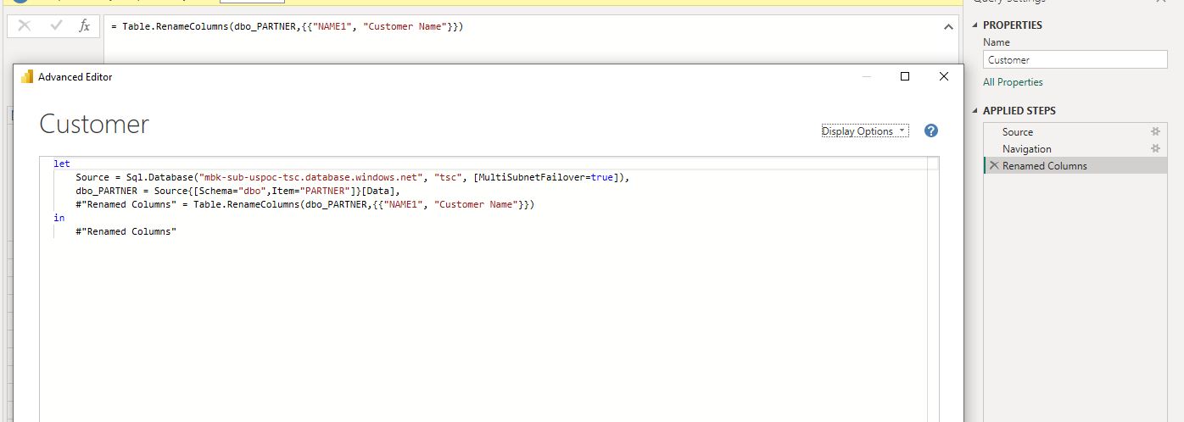
Power BI Terminology
M Code

Slide 29




Resources
https://guyinacube.com/
(7) Guy in a Cube - YouTube
https://www.sqlbi.com/
https://docs.microsoft.com/en-us/power-bi/
https://docs.microsoft.com/en-us/learn/paths/data-analytics-microsoft/
https://community.powerbi.com/
Transforming a flat file to a star schema: (78) Data Modeling (Star Schema 🌟) in Power BI – Creating Dimension Tables – YouTube
Gestalt Psychology – http://en.wikipedia.org/wiki/Gestalt_psychology
Color Matters – http://www.colormatters.com
Color palette generator - Coolors - The super fast color palettes generator!
Coblis - http://www.color-blindness.com/coblis-color-blindness-simulator/
Data Visualization Catalogue - https://datavizcatalogue.com/search.html

Slide 30
Fancy Report Stuff!
First report tutorial: (7) Create your first Power BI report (2021) - YouTube
Configure your settings: (7) Discover the Untapped Settings in Power BI Desktop – YouTube
Bookmarks: (7) Mastering Power BI Bookmarks – YouTube
(7) The BANANAS approach to use Power BI Bookmarks to swap tooltips – YouTube
Info Pane: (7) Help your Power BI report users with an Information Panel – YouTube
Buttons: (7) Taking Buttons in Power BI Desktop to the Next Level – YouTube
Toggle switch: (7) Power BI Bookmarks, Selections and Toggles - YouTube
Protip: Show your dashboard draft to someone who doesn’t know much about the data and listen to the questions they ask.

Slide 31
Demo Time
Sources:
Christmas Movies (kaggle.com)

Slide 32
Thank you

